Slide 1
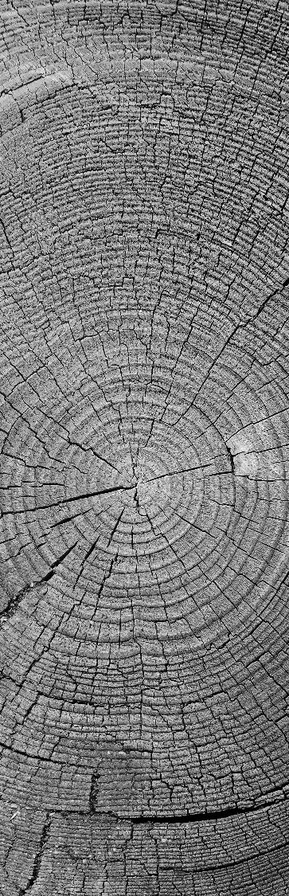
Breast CANCER prediction
Machine Learning
Faramarz Zareian
Faramarz.zareian@gmail.com

Slide 2

Dataset :Breast Cancer Wisconsin ( Diagnostic ) Dataset
Details : Features are computed from a digitized image of a fine needle aspirate (FNA) of a breast mass.
The mean, standard error and "worst" or largest (mean of the three largest values) of these features were computed for each image, resulting in 30 features. For instance, field 3 is Mean Radius, field 13 is Radius SE, field 23 is Worst Radius.
All feature values are recoded with four significant digits.
in the diagnosis column :
Malignant (Cancerous) - Present
Benign (Not Cancerous) -Absent

Slide 3
binary classification
The algorithms I used for this projects are ( Logistic Regression , Decision Tree ).
Results are based on diagnosis column which has two distinct value : ( M - B ) :
B = 357
M = 212
We have 569 rows and 32 columns
All of columns values are numerical except the diagnosis column which is categorical.

Slide 4
preprocessing
First the all columns and their rows are counted to find the (null).
After finding the columns with null values , the mean of each column calculated and we can replace the mean of each column with null values , but in this case, which is data is so sensitive its better to avoid using mean value to fill the null cells.
In this case I dropped the rows with null value due to count of null cells was not very large.

Slide 5
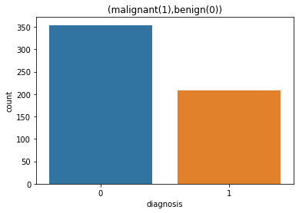
preprocessing
Now its time for change the categorical columns to numerical which is only the diagnosis column, So I used label encoder to assign unique numbers to the values ( we have only two different values M and B ), So they will be ( 1 and 0 ) after labeling .
I defined the numerical data types then if the column data type is not one of them the function change it to numerical type.

Slide 6
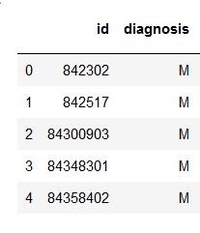
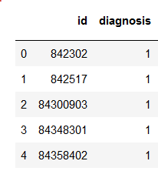
preprocessing
Before and after labeling of categorical column ( diagnosis ) :
After labeling I dropped the “id” column because we don’t need id column for predicting the cancer.

Slide 7
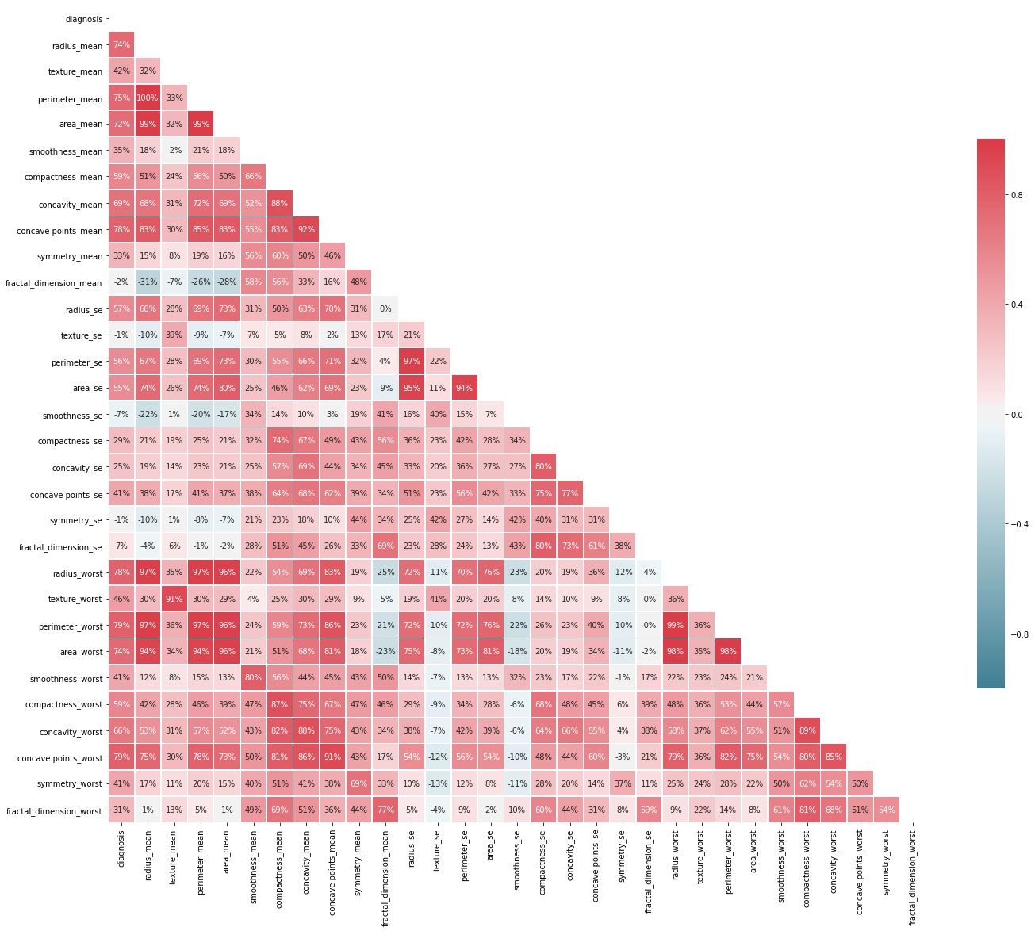
Features
features= ['area_worst','area_mean','area_se','perimeter_worst’,
'perimeter_mean','texture_mean','radius_worst','texture_worst’,
'radius_mean','perimeter_se']
In this step I chose top 10 columns with highest SCORE with selectkbest with diagnosis column as Y.
I plot it with heatmap method to visualize it for better understanding of correlation of all features together.

Slide 8

Features
I used cross validation with 5 splits on
dataset and results show the accuracy .
[0.92035398 ,0.96460177 ,0.95575221
0.94642857, 0.96396396]
Accuracy: 0.95 (+/- 0.03)

Slide 9
Algorithms
Now I made a function of Logistic Regression and Decision Tree to predict and give us the accuracy .
Logistic Regression Train Accuracy : 0.9198218262806236
Logistic Regression TEST Accuracy : 0.9469026548672567
Decision Tree ------Train Accuracy : 1.0
Decision Tree -------TEST Accuracy : 0.911504424778761

Slide 10
Confusion matrix
In this part I tried to calculate and visualize the confusion matrix and accuracy values. So we have the confusion matrix of logistic Regression and Decision Tree and based on confusion matrix,
I calculated the Accuracy and with plotting the confusion matrix show the how many True Positive , True Negative , False Positive , False Negative We had with each of algorithms.

Slide 11
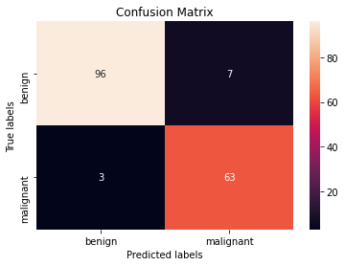
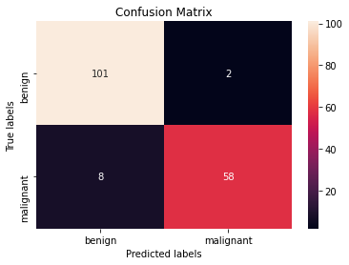
Decision Tree - Logistic regression
Decision Tree
confusion matrix is : [[96 7]
[ 3 63]]
Test Accuracy is ((tn+tp)/(tp+tn+fp+fn)): 0.9408284023668639
Logistic Regression
confusion matrix is : [[101 2]
[ 8 58]]
Test Accuracy is ((tn+tp)/(tp+tn+fp+fn)): 0.9408284023668639

Slide 12
Thank You

